Slide 1

WAY TO ENTERPRISE
DevOps Overview
VTI ACADEMY
Author: namviet0710@gmail.com
February 2024

Slide 2
Agenda
DevOps Overview
Basic network protocols concepts
Popular web servers: Apache, Nginx
Copyright © VTI Academy All Rights Reserved

Slide 3
WAY TO ENTERPRISE
About DevOps

Slide 4
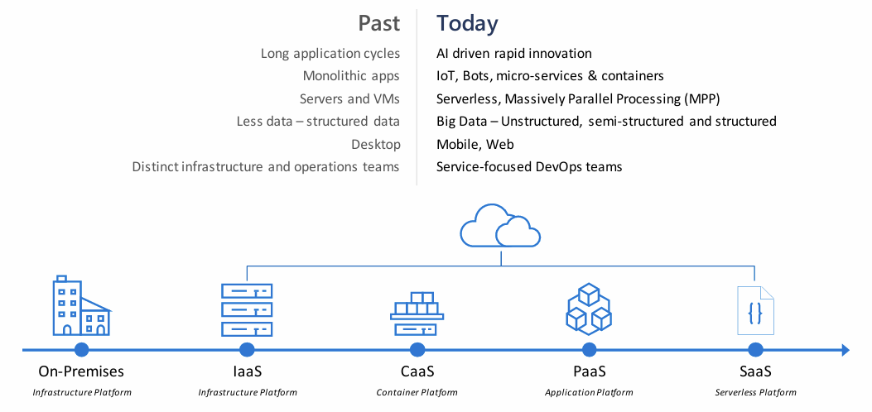
Software Development is shifting

Slide 5
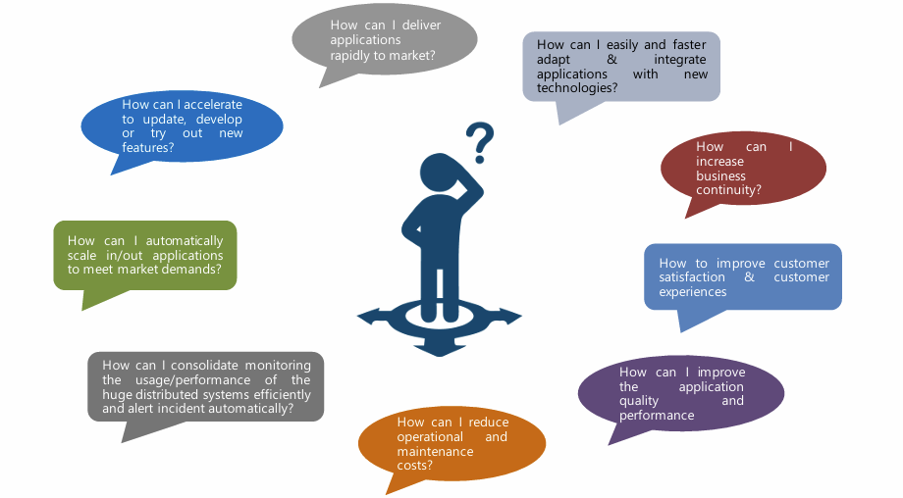
Challenges in Application Development

Slide 6
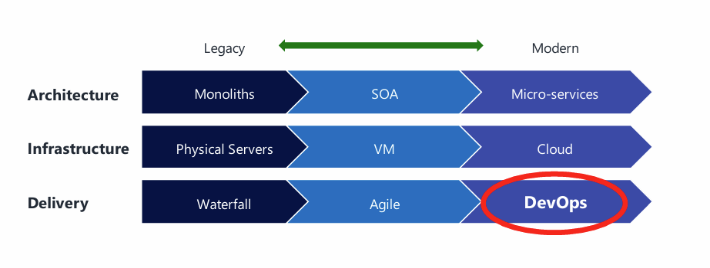
Shifting To DevOps Is Key

Slide 7
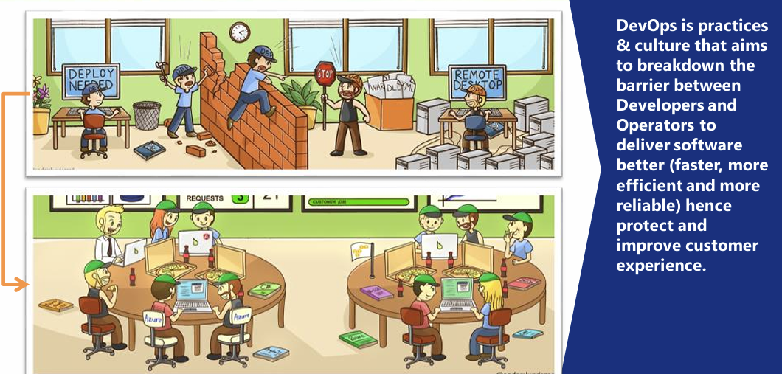
What Is DevOps?

Slide 8
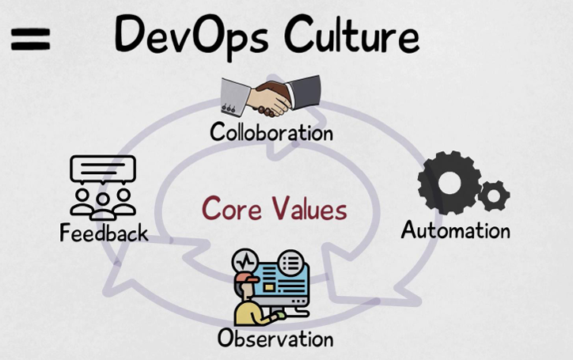
DevOps Culture

Slide 9
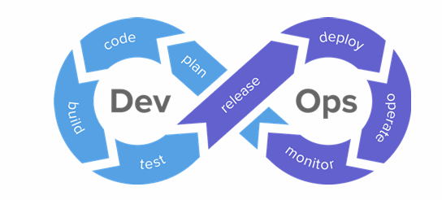
DevOps Lifecycle
• Release: change management, release approvals and move
• Deploy: infrastructure installation, app deployment, infrastructure/app configuration
• Operate: infrastructure/app management, high availability (HA), log/backup management, database management…
• Monitor: service performance monitoring, log monitoring, incident management and customer feedback. 13
• Plan: task and schedules management
• Code: version control, code review and scan
• Build: build status, packing and artifact repository
• Test: quality assurance of development through testing

Slide 10
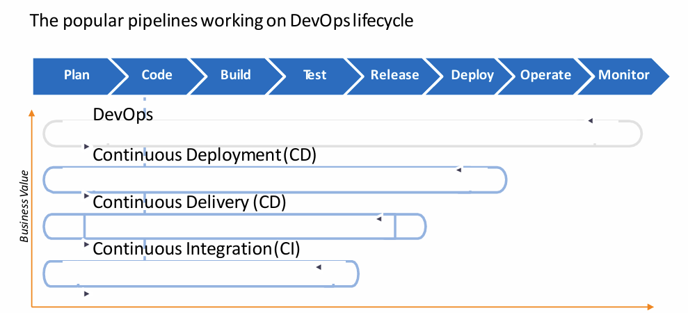
Pipelines in DevOps Lifecycle

Slide 11
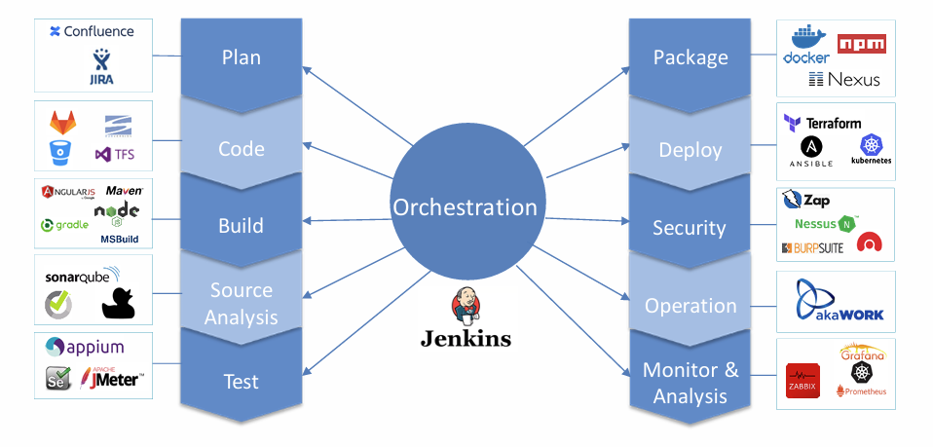
DevOps Toolchains

Slide 12
WAY TO ENTERPRISE
Basic network protocols concepts

Slide 13
DNS (Domain Name System)
Introduction
The Domain Name System (DNS) is the Internet's "phonebook," translating user-friendly domain names (like www.example.com) into IP addresses (like 192.0.2.1). This process is essential for navigating and communicating on the web.
Types of DNS Servers:
Recursive DNS Resolver: Handles query process and caching.
Authoritative DNS Server: Holds and serves domain-specific records.
Root Servers: The first step in the resolution, pointing to TLD servers.
TLD Servers: Manage domains within specific TLDs.
DNS Records:
A Record: Maps domain to an IPv4 address.
AAAA Record: Maps domain to an IPv6 address.
CNAME Record: Alias for another domain.
MX Record: Specifies mail servers.
TXT Record: Holds text data for verification and security.

Slide 14
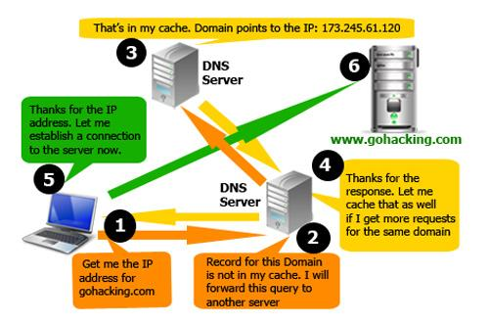
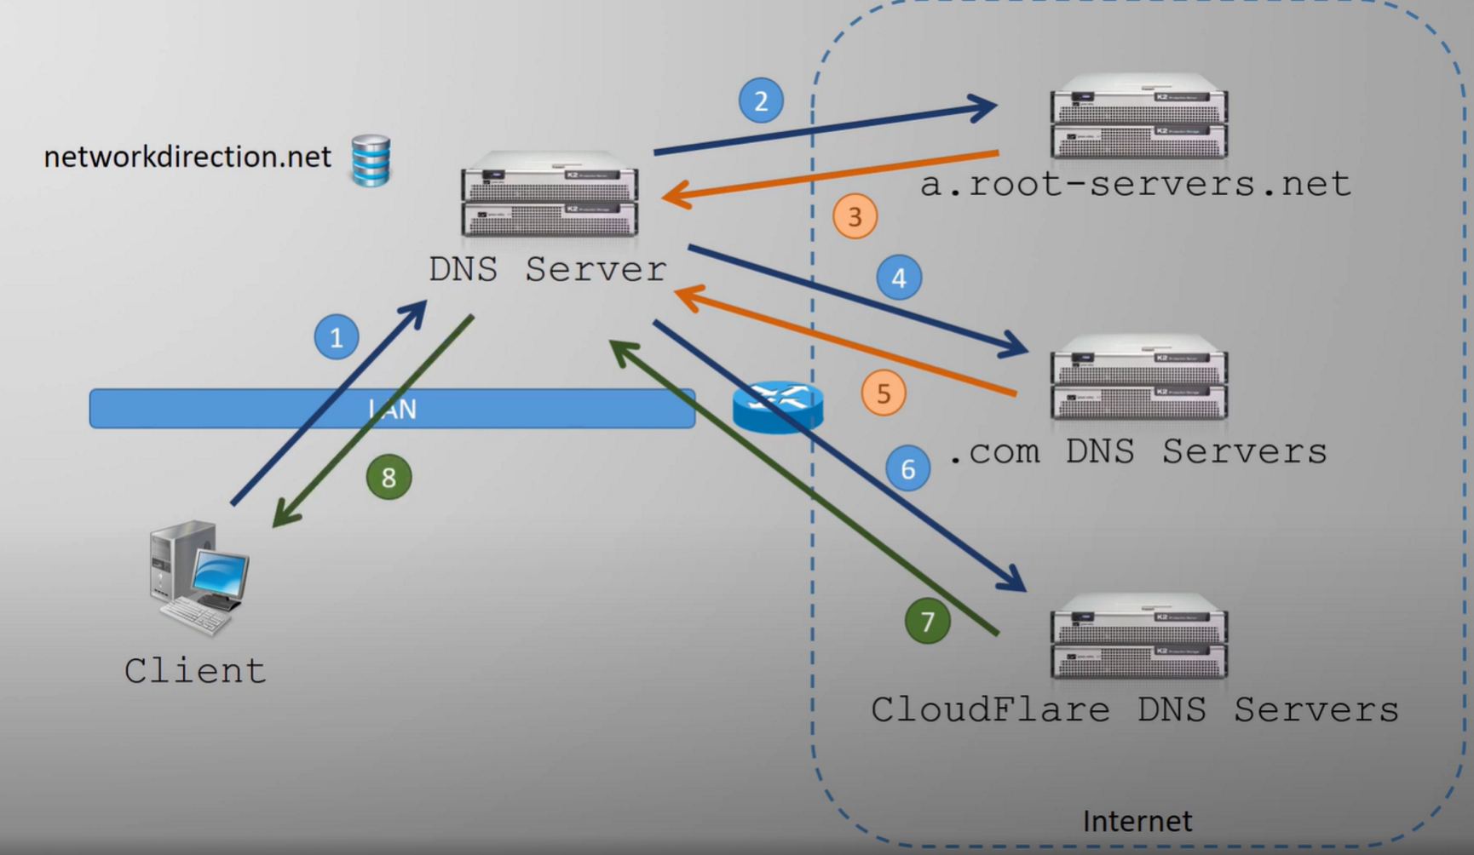
How DNS works
Using Forwarders
Using Root Hints

Slide 15
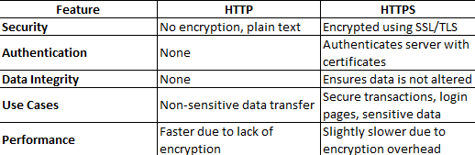
HTTP & HTTPS
HTTP (HyperText Transfer Protocol)
Purpose: The foundational protocol for transferring data on the web.
Key Features: Stateless, request-response model where clients send requests to servers which then respond with the appropriate resources (HTML, images, etc.).
HTTPS (HTTP Secure)
Purpose: Secure version of HTTP that encrypts data to protect the integrity and confidentiality of the communication between the client and server.
Key Features: Utilizes SSL/TLS for encryption, ensuring data cannot be intercepted or tampered with.
Comparing HTTP and HTTPS

Slide 16
When to Use HTTP vs. HTTPS
HTTP:
Suitable for non-sensitive data transfer, like delivering public content on websites where security is not a concern.
However, its use is increasingly discouraged as modern best practices favor secure communication for all web traffic.
HTTPS:
Essential for any website handling sensitive information, such as user logins, personal data, or financial transactions.
Recommended for all websites to enhance security, user trust, and potentially improve SEO rankings.

Slide 17
FTP & SSL
FTP (File Transfer Protocol)
Purpose: Standard protocol for transferring files between computers over a network.
Key Features: Supports simple file upload/download operations; can be less secure compared to newer protocols like SFTP (Secure FTP).
SSL (Secure Sockets Layer) / TLS (Transport Layer Security)
Purpose: Protocols for establishing secure communication channels over a network.
Key Features: SSL/TLS encrypts data in transit, ensuring privacy and data integrity. TLS is the successor to SSL and is more secure

Slide 18
WAY TO ENTERPRISE
Popular web servers: Apache, Nginx

Slide 19
Apache HTTP Server
Intro
The Apache HTTP Server serves as the backbone for many websites and web applications, delivering content over the Internet. Apache is known for its flexibility, power, and extensive module support, making it a preferred choice for many developers and administrators.
Installing:
sudo apt update
sudo apt install apache2
sudo systemctl start apache2 # Ubuntu/Debian
sudo systemctl start httpd # CentOS/RHEL
sudo systemctl stop apache2
sudo systemctl restart apache2
Configuration File
The main configuration file for Apache is httpd.conf, usually located in /etc/httpd/conf or /etc/apache2 on Linux.

Slide 20
Nginx
Introduction
Nginx is a high-performance, open-source web server and reverse proxy server known for its efficiency, scalability, and low resource consumption.
Installing and Using:
sudo apt update
sudo apt install nginx
sudo systemctl start nginx
sudo systemctl stop nginx
sudo systemctl restart nginx
nginx –t
nginx –s reload
Configuration File
The main configuration file for Nginx is nginx.conf, typically located in /etc/nginx/nginx.conf on Linux systems. Additional configuration files can be included and are usually located in /etc/nginx/conf.d/

Slide 21
Basic Directives in Nginx
server: Defines a virtual server block to handle requests
location: Sets up rules to process specific URL patterns.
listen: Configures the port and IP address for the server to listen on
Example:
server {
listen 80;
server_name example.com www.example.com;
root /var/www/html;
location / {
try_files $uri $uri/ =404;
}
}
Security Configurations: Enable SSL with SSL/TLS configuration for secure HTTPS connections
Example:
server {
listen 443 ssl;
server_name example.com;
ssl_certificate /etc/nginx/ssl/example.com.crt;
ssl_certificate_key /etc/nginx/ssl/example.com.key;
location / {
root /var/www/html;
index index.html;
}
}

Slide 22
Basic Directives in Nginx
Initial example: Using cert-bot to get SSL cert. The file below is stored in /etc/nginx/conf
server {
server_name home.example.com;
client_max_body_size 0;
location / {
proxy_set_header Host $http_host;
proxy_set_header X-Real-IP $remote_addr;
proxy_set_header X-Forwarded-For $proxy_add_x_forwarded_for;
proxy_set_header X-Forwarded-Proto $scheme;
proxy_pass http://10.1.1.193:88;
proxy_redirect off;
proxy_pass_request_headers on;
}
listen 443 ssl;
ssl_certificate /etc/letsencrypt/live/ home.example.com /fullchain.pem;
ssl_certificate_key /etc/letsencrypt/live/ home.example.com /privkey.pem;
}
server {
server_name home.example.com;
listen 80;
location / {
return 301 https://$server_name$request_uri;
}
}
Reverse Proxy Configuration: Nginx can forward client requests to backend servers, acting as a reverse proxy.
Example:
server {
listen 80;
server_name proxy.example.com;
location / {
proxy_pass http://backend_server;
proxy_set_header Host $host;
proxy_set_header X-Real-IP $remote_addr;
proxy_set_header X-Forwarded-For $proxy_add_x_forwarded_for;
proxy_set_header X-Forwarded-Proto $scheme;
}
}

